Slide 1
Making Presentations That Stick
A guide by Chip Heath & Dan Heath

Slide 2

Selling your idea
Created in partnership with Chip and Dan Heath, authors of the bestselling book Made To Stick, this template advises users on how to build and deliver a memorable presentation of a new product, service, or idea.

Slide 3


1. Intro
Choose one approach to grab the audience’s attention right from the start: unexpected, emotional, or simple.
Unexpected Highlight what’s new, unusual, or surprising.
Emotional Give people a reason to care.
Simple Provide a simple unifying message for what is to come

Slide 4
How many languages do you need to know to communicate with the rest of the world?
Tip
In this example, we’re leading off with something unexpected.
While the audience is trying to come up with a number, we’ll surprise them with the next slide.

Slide 5
Just one! Your own.
(With a little help from your smart phone)
Tip
Remember. If something sounds like common sense, people will ignore it.
Highlight what is unexpected about your topic.

Slide 6

The Google Translate app can repeat anything you say in up to NINETY LANGUAGES from German and Japanese to Czech and Zulu
Tip
Don’t wait till the end of the presentation to give the bottom line.
Reveal your product or idea (in this case a translation app) up front.

Slide 7
2. Examples
By the end of this section, your audience should be able to visualize:
What What is the pain you cure with your solution?
Who Show them a specific person who would benefit from your solution.

Slide 8

Meet Alberto.
He recently moved from Spain to a small town in Northern Ireland.
He loved soccer, but feared he had no way to talk to a coach or teammates.
Tip
Tell the audience about the problem through a story, ideally a person.

Slide 9

Meet Marcos.
He recently opened a camera shop near the Louvre in Paris.
Visitors to his store, mostly tourists, speak many different languages making anything beyond a simple transaction a challenge.
Tip
If one example isn’t sufficient to help people understand the breadth of your idea, pick a couple of examples.
Story for illustration purposes only

Slide 10
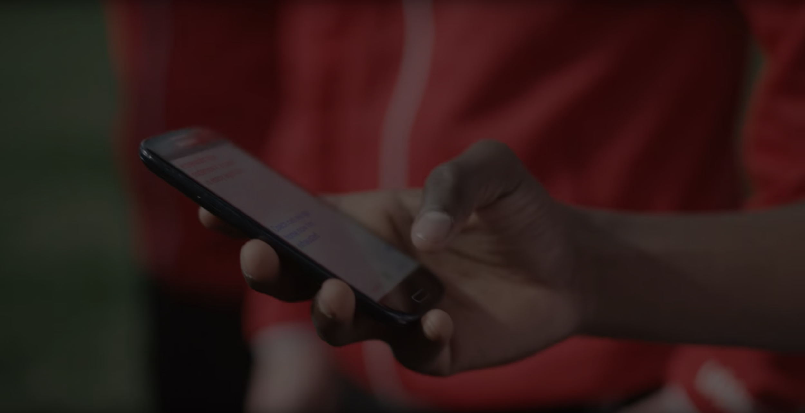
A translation barrier left Alberto feeling lonely and hurt Marco’s business.
Tip
Ideally, speak of people in very different situations, but where each could benefit from your solution.

Slide 11

Then, Marcos discovered Google Translate
He has his visiting customers speak their camera issues into the app.
He’s able to give them a friendly, personalized experience by understanding exactly what they need.

Slide 12
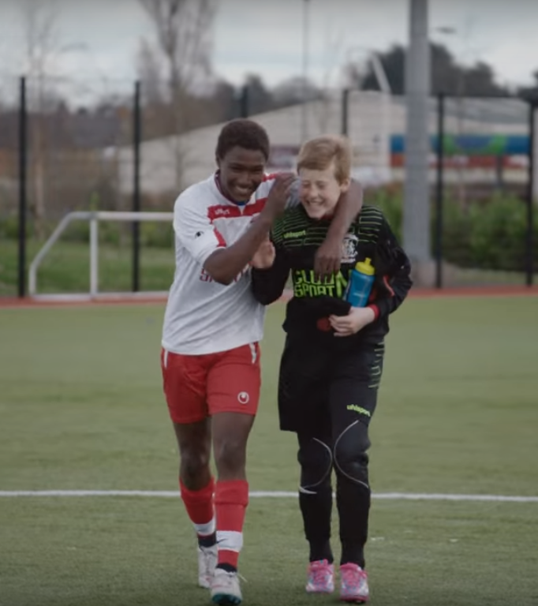
A simple gesture
Coaches Gary and Glen knew no Spanish.
They used Google Translate to invite Alberto to join in... “Do you want to play?”... “Can you defend the left side?”
Tip
Show how your solution helps the person in the story reach his or her goals.

Slide 13

From outsider to star
Alberto scored 30 goals in 21 games. He is now being scouted by several professional clubs in the Premier League. And he’s a favorite of the other boys on the team.
See a short video on Alberto’s story
Tip
Stories become more credible when they use concrete details such as the specific complex moves Alberto learned through Translate and his 30 goals in 21 games performance stats.

Slide 14
3. Examples
People need to understand how rare or frequent your examples are.
Pick 1 or 2 statistics and make them as concrete as possible. Stats are generally not sticky, but here are a few tactics:
Relate Deliver data within the context of a story you’ve already told
Compare Make big numbers digestible by putting them in the context of something familiar

Slide 15
It’s no surprise Marcos uses Google Translate in his shop regularly.
There are 23 officially recognized languages in the EU.
Tip
Don’t let data stand alone. Always relate it back to a story you’ve already told, in this case, Marco’s shop.
Source: theguardian.com

Slide 16


More than 50 million Americans travelled abroad in 2015
THAT’S MORE THAN THE POPULATION OF
CALIFORNIA AND TEXAS COMBINED
Tip
When a number is too large or too small to easily comprehend, clarify it with a comparison to something familiar.
Source: travel.trade.gov

Slide 17
4. Closing
Build confidence around your product or idea by including at least one of the these slides:
Milestones What has been accomplished and what might be left to tackle?
Testimonials Who supports your idea (or doesn’t)?
What’s next? How can the audience get involved or find out more?

Slide 18
Milestones
October 2014
October 2015
August 2015
November 2015
Translate web pages with Chrome extension
Translate text within an app
2014 |  |  |  | 2015
Translate conversations through your Android watch
Translate written text from English or German to Arabic with the click of a camera

Slide 19
What people are saying
With this app, I’m confident to plan a trip to rural Vietnam
Wendy Writer, CA
Visual translation feels like magic
Ronny Reader, NYC
Translate has officially inspired me to learn French
Abby Author, NYC
Quotes for illustration purposes only

Slide 20

Know a 2nd language? Make Google Translate even better by joining the community.
Tip
Inspire your audience to act on the information they just learned.
Depending on your idea, this can be anything from downloading an app to joining an organization.

Slide 21
Good luck!
We hope you’ll use these tips to go out and deliver a memorable pitch for your product or service!
For more (free) presentation tips relevant to other types of messages, go to heathbrothers.com/presentations
For more about making your ideas stick with others, check out our book!

